Slide 1
Client/Server Computing
(the wave of the future)

Slide 2
Agenda
Why client server ?
Models
Architecture
Tools
Applications
Conclusions

Slide 3
Traditional Program Architecture
In a traditional programs the user interface is closely coupled with the rest of the program.
The program must be installed on the client machine
Any data the program needs is also saved and loaded by the program on the machine it is installed on.
Any processing of the data is performed by the program on the machine it is installed on.
Internally the program may be divided up into modules, objects, layers etc.
Application
Interface
Application
and
Data storage

Slide 4
A simple definition
A simple definition of CS is
“ server software accepts requests for data from client software and returns the results to the client”

Slide 5
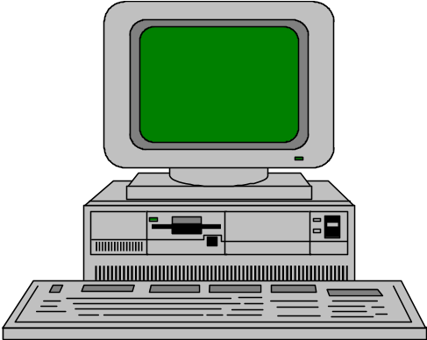


Elements of C-S Computing
a client, a server, and network
Request
Client
Server
Network
Result
Client machine
Server machine

Slide 6
Where Operations are Done
In CS Relationship “most of the application processing is done on a computer (client side), which obtains application services (such as database services) from another computer (server side) in a master slave configuration

Slide 7
CS-Focus is on
In client-server computing major focus is on SOFTWARE

Slide 8
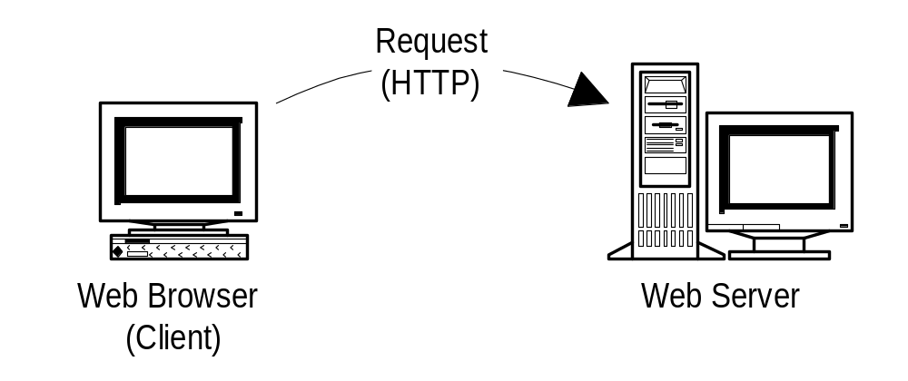
Web Apps are Client/Server

Slide 9
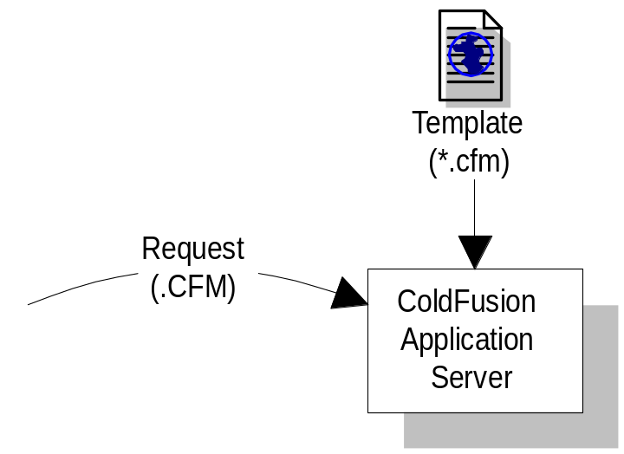
Web Apps are Client/Server

Slide 10
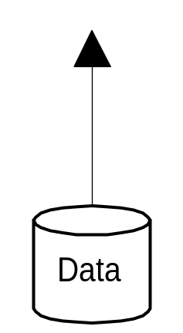
Web Apps are Client/Server

Slide 11
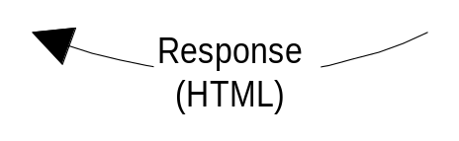
Web Apps are Client/Server

Slide 12
Web Apps are Client/Server

Slide 13



Application Tasks
User Interface
Presentation Logic
Application Logic
Data Requests & Results
Physical Data Management

Slide 14
Client (dumb) - Server Model
Server
Client
Keystroke
Presentation Logic
Network
Application Logic
Displays
DBMS

Slide 15
True Client-Server Model
Server
Client
Keystroke
Presentation Logic
Application Logic
Network
DBMS
Processed
Results

Slide 16
Distributed Client-Server Model
Server
Client
Processed
Queries
Application Logic
Application Logic
Network
DBMS
Presentation Logic
Processed
Results

Slide 17
Client-server computing is distributed access, not a distributed computing.

Slide 18

RPC Look and Feel like Local Calls
results=
bar(arguments)
calling
procedure
results=
bar(arguments)
called
procedure
calling
procedure
(client)
results=
bar(arguments)
arguments
results
results
arguments
client stub
network transport
server stub
network transport
arguments
results
called
procedure
(client)
request message
reply message
reply message
request message
Network
Local Procedure Call
Remote Procedure Call

Slide 19

Flow Control in a Sychronous RPC
Client Machine
Server Machine
Service Daemon Listening
Client
Program
RPC Call
Invoke Service
with Request
Service Call
Client
Waiting
Service Executes
Network
return() answer
return ( )
Request Completed
reply
May be the same machine

Slide 20
Multithreaded Server
Server Process
Client Process
Server
Threads
Client Process
User Mode
Kernel Mode
Message Passing
Facility

Slide 21
Categories of Servers
File Server
Data Server
Compute Server
Database Server
Communication Server
Video Server

Slide 22
File Server
File Servers manage a work group’s application and data files, so that they may be shared by the group.
Very I/O oriented
Pull large amount of data off the storage subsystem and pass the data over the network
Requires many slots for network connections and a large-capacity, fast hard disk subsystem.

Slide 23
Compute Server
Performs Application logic processing
Compute Servers requires
  processors with high performance capabilities
  large amounts of memory
  relatively low disk subsystems
By separating data from the computation processing, the compute server’s processing capabilities can be optimized

Slide 24
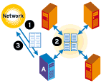
Cluster as Compute Server

Slide 25
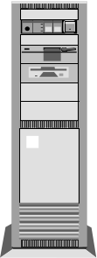
Data Server
Data-oriented; used only for data storage and management
Since a data server can serve more than one compute server, compute-intensive applications can be spread among multiple severs
Does not prefer any application logic processing
Performs processes such as data validation, required as part of the data management function.
Requires fast processor, large amount of memory and substantial Hard disk capacity.
Data
Server
Compute
Server

Slide 26
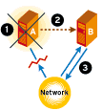
Cluster as High Availablity Data Server
Data
Server
Compute
Server

Slide 27
Database Server
Most typical use of technology in client-server
Accepts requests for data, retrieves the data from its database(or requests data from another node)and passes the results back.
Compute server with data server provides the same functionality.
The server requirement depends on the size of database, speed with which the database must be updated, number of users and type of network used.

Slide 28
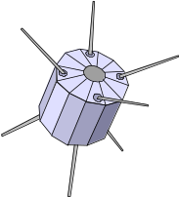


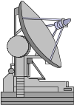
Communication Server
Provides gateway to other LANs, networks & Computers
E-mail Server & internet server
Modest system requirements
  multiple slots
  fast processor to translate networking protocols

Slide 29
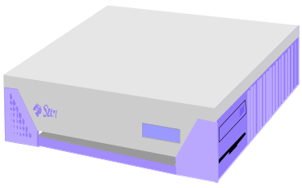
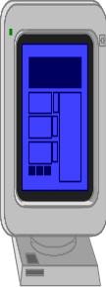
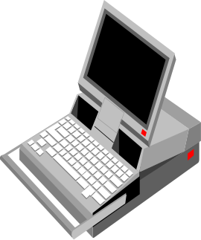
Internet Server
PC client
Internet Server
Local Area
Network
UNIX workstations

Slide 30
Distributed processing application connects to remote database
S Q L *
Forms
SQL *Net
TCP/IP
UNIX Server
Distributed database application connects to local database which connects to remote database
SQL *Net
TCP/IP
SQL *
Forms
ORACLE
SQL *Net
TCP/IP
ORACLE
Database Configurations

Slide 31
Ethernet era
client/server
Intergalactic era
client/server
First Wave
Second Wave
Third Wave
Database
servers
File
servers
Distributed
objects
groupware
TP
monitors
1982
1986
1990
1994
1998

Slide 32
The Client/Server Infrastructure
Client
Middleware
Server
Service Specific
SQL/IDAPI
TxRPC
Mail
ORB
Objects
GUI/OOUI
DSM
Groupware
SNMP
CMIP
DME
TP
monitor
NOS
Directory
Security
Distributed file
RPC
Messaging
Peer-to-peer
DBMS
DSM
Transport Stack
DSM
Operating System
NetBIOS
TCP/IP
IPX/SPX
SNA
Operating System

Slide 33
Internet Programs and the Client Server Model
The advent of the internet provided a new way of structuring programs...
One such model is the client server model.
This divides the program up into two parts
  One part is installed on the client and runs on the client
  One part is installed on the server and runs on it
  The exact division of tasks between the client and server is up to the program developer
  Typically servers are fast and reliable (and expensive) and so important and complex tasks are performed on them
  Typically clients perform simple tasks and interact with the user via a GUI

Slide 34
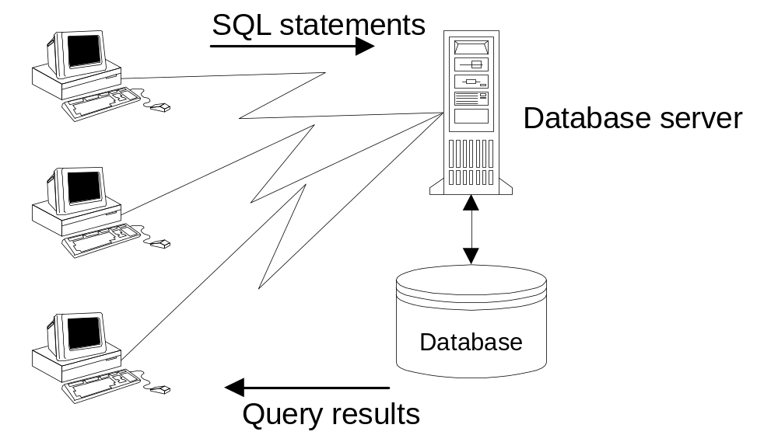
Two-Tier Architecture
Notes:
The two-tier architecture features a PC client and a database server as shown in this figure. The PC client contains the presentation code and SQL statements for data access. The database server processes the SQL statements and sends query results back to the PC client. In addition, the database server performs process management functions. The validation and business logic code can be split between the PC client and the database server. The PC client can invoke stored procedures on the database server for business logic and validation. Typically, much of the business logic code resides on the client. PC clients in a two-tier architecture are sometimes called “fat clients” because of the large amount of business logic they contain.

Slide 35
Two-Tier Client-Server Architecture
A PC client and a database server interact directly to request and transfer data.
The PC client contains the user interface code.
The server contains the data access logic.
The PC client and the server share the validation and business logic.
Notes:
The two-tier architecture is a good approach for systems with stable requirements and a moderate number of clients. On the positive side, the two-tier architecture is the simplest to implement due to the number of good commercial development environments. On the negative side, software maintenance can be difficult because PC clients contain a mix of presentation, validation, and business logic code. To make a significant change in business logic, code must be modified on many PC clients. In addition, utilizing new technology may be difficult because two-tier architectures often rely on proprietary software rather than open standards. To lessen reliance on a particular database server, the PC client can connect to intermediate database drivers such as the Open Database Connectivity (ODBC) drivers instead of directly to a database server. The intermediate database drivers then communicate with the database server.
Performance can be poor when a large number of clients submit requests because the database server may be overwhelmed with managing messages. Several sources report that two-tier architectures are limited to about 100 simultaneous clients. With a larger number of simultaneous clients, a three-tier architecture may be necessary. In addition, connecting to intermediate drivers rather than directly to a database server can slow performance.

Slide 36
2-Tier Architecture Client Server
A 2-Tier architecture contains a presentation tier and an application+data tier.
Presentation tier or Client interacts with the user and sends requests to the application layer (server)
Application tier (server) performs processing on behalf of the client and sends it the results to display it is also responsible for any data storage
Network

Slide 37
Example – Web Browsing
A classic example of the client server model is the World Wide Web. Which relies on the Internet to transfer data
A set of web servers hold HTML web pages on disk and provide them to clients web browsers on demand.
This is termed a 2 tier model because the web server does not directly rely on other servers
  The server is called the application tier
  The client is called the presentation tier

Slide 38
2 – Tier Web Based Programs
Modern web servers allow the user to write programs which generate the HTML the client's web browser will display.
This is still a two tier system because the programs are under the control of the web browser and are not independent of it.
The programs the web server runs are responsible for doing the processing and data storage to generate the web pages the server will send to the client.

Slide 39
2 – Tier Web Based Programs
In Web program scenario, the browser provides a universal user interface through client-side technology (HTML, JavaScript)
The application runs on the server side to handle client requests and ASP, JSP, Servlets or other technologies generate the HTML
Web server
Program
and
Storage
client
browser
interface
Network
Send request for a web page
response (generated HTML)

Slide 40
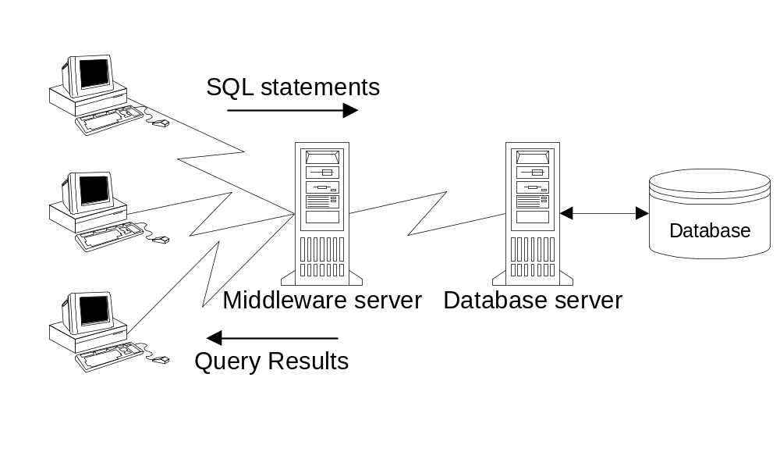
Three-Tier Architecture (Middleware Server)
Notes:
One way to improve performance is to add a middleware server to handle process management. The middleware usually consists of a transaction-processing monitor or message-oriented middleware. A transaction-processing monitor may support more simultaneous connections than message-oriented middleware. However, message-oriented middleware provides more flexibility in the kinds of messages supported.

Slide 41
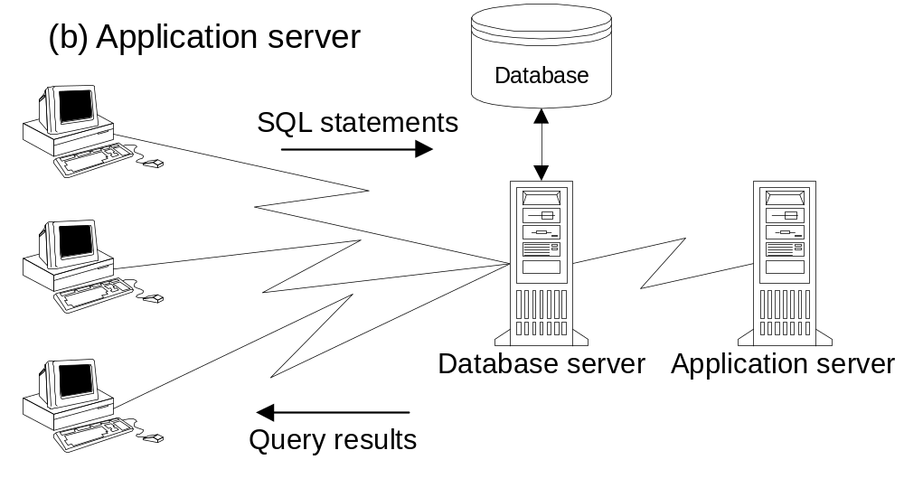
Three-Tier Architecture (Application Server)
Notes:
A second way to improve performance is to add an application server for specific kinds of processing such as report writing.

Slide 42
Three-Tier Architecture
To improve performance, the three-tier architecture adds another server layer either by a middleware server or an application server.
The additional server software can reside on a separate computer.
Alternatively, the additional server software can be distributed between the database server and PC clients.
Notes:
Three-Tier Architecture: A client-server architecture with three layers: a PC client, a backend database server, and either a middleware or an application server.
Although the three-tier architecture addresses performance degradations of the two-tier architecture, it does not address division-of-processing concerns. The PC clients and the database server still contain the same division of code although the tasks of the database server are reduced.

Slide 43
Multiple-Tier Architecture
A client-server architecture with more than three layers: a PC client, a backend database server, an intervening middleware server, and application servers.
Provides more flexibility on division of processing
The application servers perform business logic and manage specialized kinds of data such as images.
Notes:
The multiple-tier architecture is the most general client-server architecture. It can be the most difficult to implement because of its generality. However, a good design and implementation of a multiple-tier architecture can provide the most benefits in terms of scalability, interoperability, and flexibility.

Slide 44
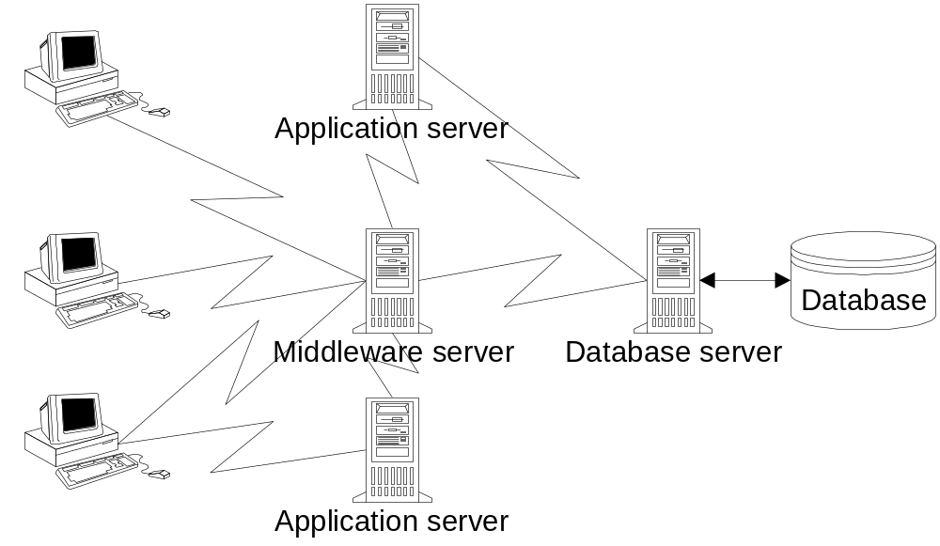
Multiple-Tier Architecture
Notes:
To improve performance and provide flexible division of processing, multiple tier architectures support additional layers of servers, as depicted in this figure.
The application servers can be invoked from PC clients, middleware, and database servers. The additional server layers provide a finer division of processing than a two- or a three-tier architecture. In addition, the additional server layers can also improve performance because both middleware and application servers can be deployed.

Slide 45
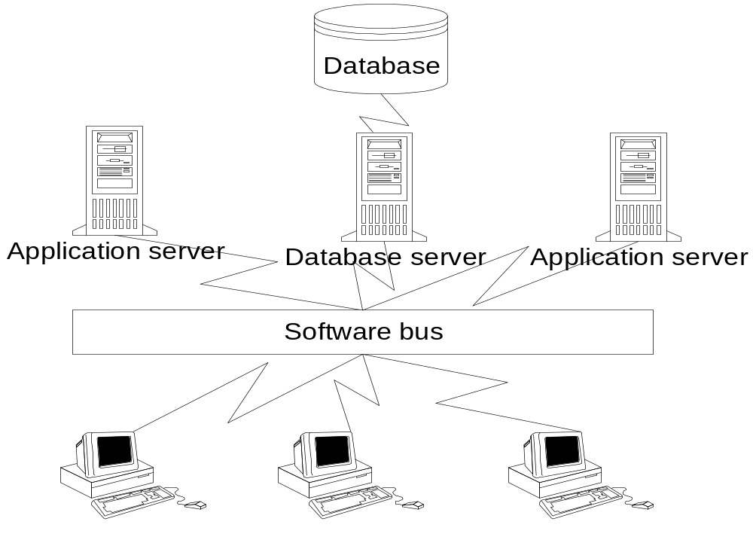
Multiple-Tier Architecture with Software Bus
Notes:
Software buses provide a flexible and standard approach for multiple-tier architectures, as shown in this figure. A software bus resolves differences among server and client platforms. Software units of code or objects can be located on any server, even replicated on multiple servers to improve reliability. PC clients can request objects without knowing the platform, location, or implementation details of the object. Currently, there are three candidates for software buses: the Common Object Request Broker Architecture (CORBA) of the Object Management Group, the Distributed Component Object Model (COM+) of Microsoft, and Enterprise Java Beans of Sun Microsystems. All three approaches operate over the Internet and corporate intranets as described in the next section.

Slide 46
Internet Basics
Network of networks
Uses standard protocols: TCP/IP
  TCP: splits messages into packets
  IP: routes messages
Each computer on the Internet has a unique numeric address known as an IP address.
Notes:
The Internet provides resource sharing among thousands of networks. For this reason it is called a “network of networks.” To provide resource sharing among different kinds of computers, operating systems, and communication equipment, the Internet uses standard protocols. A protocol is a fancy word for a rule about group behavior or interaction. Internet uses the Transmission Control Protocol (TCP) and the Internet Protocol (IP) to communicate among networks. The TCP splits messages into fixed-length units called datagrams or packets, reassembles them at the other end, resends lost datagrams, and rearranges them in the right order. The IP routes individual datagrams among networks. Routing can be a complex task because of incompatibilities among networks, many possible routes, and the changing status of routes. To facilitate routing, each computer on the Internet has a unique numeric address known as an IP address.

Slide 47
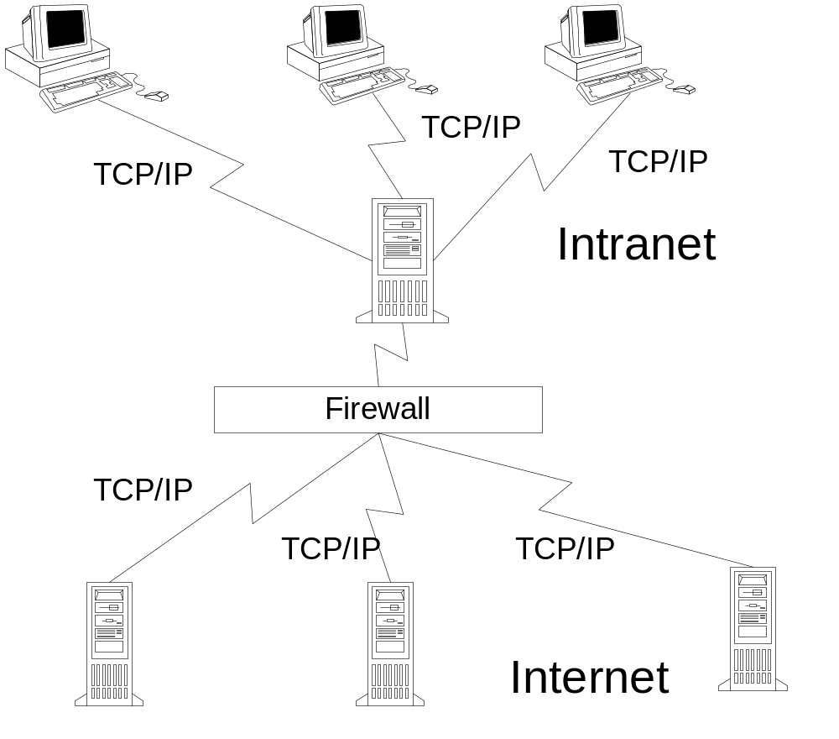
Internet and Intranet Relationship
Notes:
In addition to Internet usage, the TCP/IP protocols are used for private networks known as intranets. An intranet is a collection of computers and communication devices using the TCP/IP protocol. However, for security reasons, computers in an intranet are usually not accessible from computers on the Internet. For added security, an intranet can be protected from outside access by a firewall.

Slide 48
World Wide Web
Most popular application on the Internet
Supports browsing pages located on any computer on the Internet
Hypertext Transport Protocol (HTTP) establishes a session between a browser and a Web server.
Each page has a unique address known as a URL.
Notes:
The most popular application on the Internet is the World Wide Web (WWW). Using the WWW, you can browse pages located on any computer on the Internet.
Another set of standards provides the foundation for the WWW. The Hypertext Transfer Protocol (HTTP) establishes a session between a browser and a Web server. . During the session, the browser and the server interact to send and receive files containing Web pages. Each page has a unique address known as a Uniform Resource Locator (URL). The first part of a URL specifies the protocol of a service. The second part of a URL specifies a computer on the Internet containing the file. Communication devices such as routers and gateways translate the second part into a numeric IP address. The third part of a URL specifies a path to a file containing the page.

Slide 49
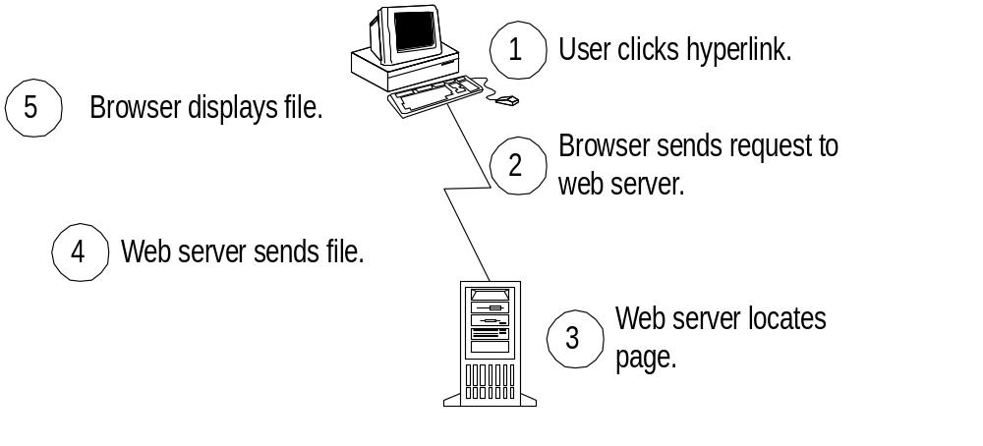
Web Page Request Cycle
Notes:
The browser and the server work together to send and receive pages. Web pages are written in a language called the Hypertext Markup Language (HTML). A browser displays pages on a PC by interpreting HTML code in the file sent by a server. Part of the HTML code can contain hyperlinks or requests for other pages. When a user clicks on a hyperlink, the browser sends a request to a server to retrieve the page as depicted in this figure. The server locates the file containing the page and sends it to the requesting browser. The user then sees the requested page after the browser interprets the HTML code in the file.
As the Web explosively grows, HTML has a number of limitations that have become more pronounced which have led to the development of the eXtensible Markup Language (XML) and the eXtensible Style Language (XSL). In contrast to HTML, XML provides a clean separation between the structure and the content of a document. XSL supports transformation of XML documents into HTML and other display languages.
In terms of the Web page request cycle of this figure, the server and/or the browser may be capable of processing XML and XSL in addition to HTML. If the browser contains XML and XSL processors, the server can send XML and XSL to the browser instead of HTML. The browser then can transform the XML and XSL into HTML and then display the HTML. If the browser does not contain XML and XSL processors, the server can process the XML and XSL and send HTML to the browser.

Slide 50

Thank You ...
?

